Slide 1
Image Segmentation by Genetic Algorithm
Lin Huangjing , SID: 1155072677
ENGG5189 Evolutionary Computation Paper Presentation

Slide 2

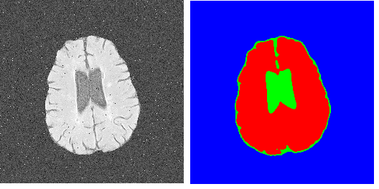
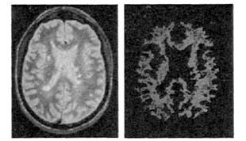
Background
What is segmentation?
Notes:
1.5 min

Slide 3
Motivation
Importance of the Segmentation
Central Problem in Pattern Recognition
Be widely used in medical diagnosis
Be useful in 3-D modeling
…..
Notes:
1 min

Slide 4
Problem Definition
Segmentation
Non-overlapping and connected regions
Homogeneity of clustered pixels
Intensity
Color
Texture
Semantic information
Notes:
1 min

Slide 5
Method Overview
“An Evolutionary Approach for Image Segmentation”
Alessia Amelio & Clara Pizzuti,
MIT Press Journals
Notes:
1.5 min

Slide 6
Method Overview
Introduce in the Genetic Algorithm (GA)
Propose a novel dissimilarity evaluation function “Weight Normalized Cut (WNCut)” based on the previous “Ncut”
Automatically adjust the k number of objects without setting in advance
Notes:
1.5 min

Slide 7
Method Overview
Algorithm
Pre-processing
Denoise
Resize
Segmentation
Converse to gray scale
Perform GeNCut calculation
Contour extraction
Resize to original size
Canny edge detection
Notes:
1.5 min
association

Slide 8
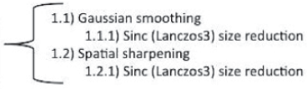
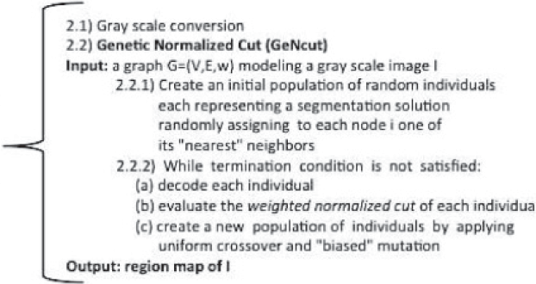

Method Overview
Algorithm
Input Image
Pre-Processing
Segmentation
Contour Extraction
Image Boundaries
Notes:
1.5 min
association

Slide 9

Method Overview
Definition of Image
Define the image as a graph G = (V, E, W)
V → the set of n nodes of G
E → the set of edges
W → is a set of values corresponding to edges
1, 2, 3, …… 16
1
2
3
..
16
W is a Matrix calculated by w(i,j)
Represent the affinity between pixels
image ( n = 4x4 = 16 )
Notes:
1.5 min

Slide 10
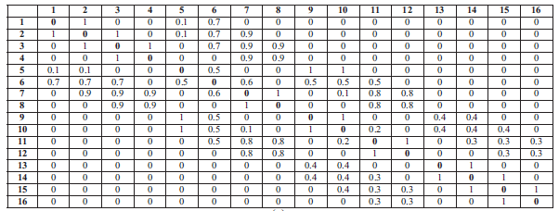
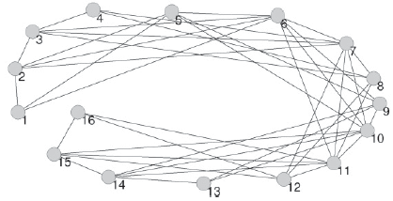
Method Overview
Definitions of Image
Notes:
1.5 min

Slide 11

Method Overview
Weight Definition
Edge(x) is the image edge strength at position x
r is the distance threshold
line(i, j) is the straight line between i and j
Notes:
2 min

Slide 12
Method Overview
Weight Definition
Find the max Edge(x)
value on the line
r
i
j
Notes:
2 min

Slide 13
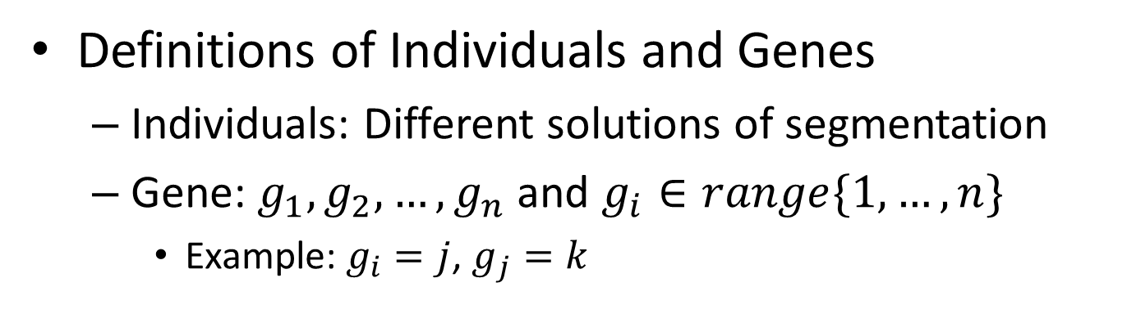
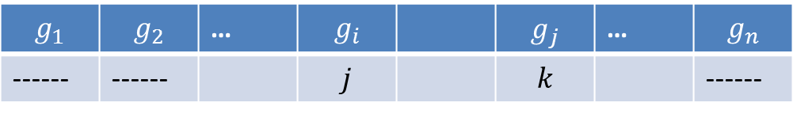
Method Overview
Definitions of Individuals and Genes
Individuals: Different solutions of segmentation
Gene: $g_{1}, g_{2},…, g_{n}$ and $g_{i}∈range\{1,…, n\}$
Example: $g_{i}=j$, $g_{j}=k$
$$g_{1}$$ | $$g_{2}$$ | … | $$g_{i}$$ |  | $$g_{j}$$ | … | $$g_{n}$$
------ | ------ |  | $$j$$ |  | $$k$$ |  | ------
i
j
k
Notes:
1.5 min

Slide 14

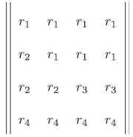
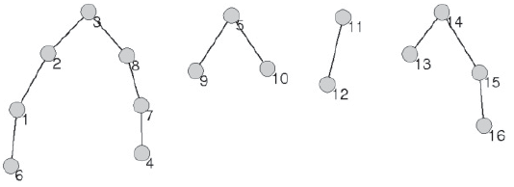


Method Overview
Definitions of Individuals and Genes
$$g_{i}:$$
j$:$
&
Notes:
1.5 min

Slide 15
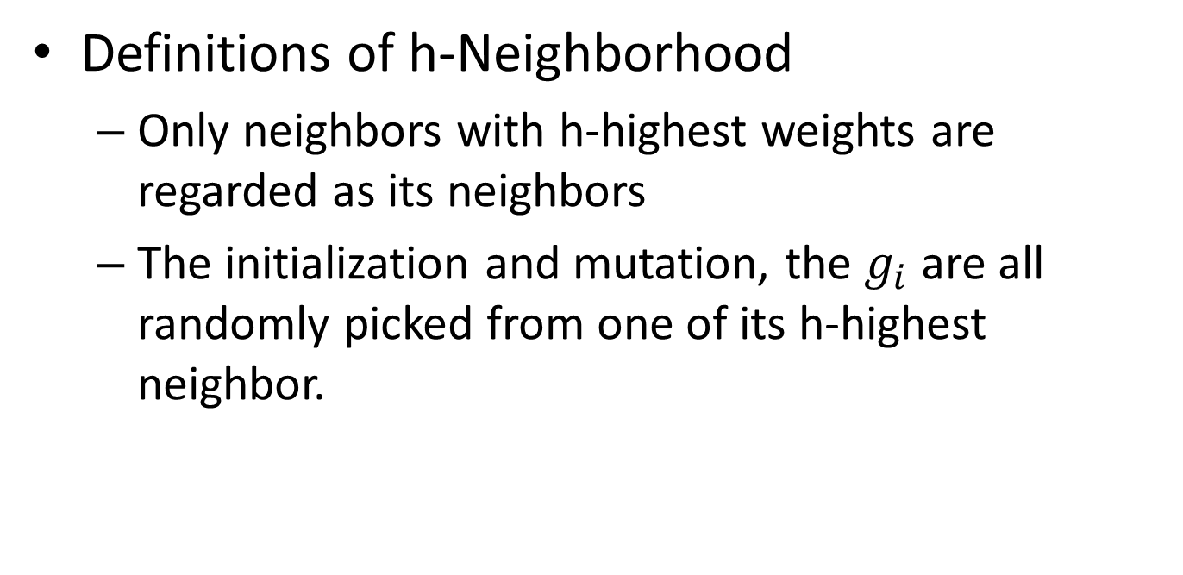
Method Overview
Definitions of h-Neighborhood
Only neighbors with h-highest weights are regarded as its neighbors
The initialization and mutation, the $g_{i}$ are all randomly picked from one of its h-highest neighbor.
Notes:
1.5 min

Slide 16
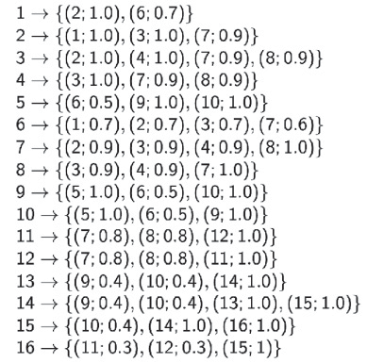
Method Overview
h=2, only neighbors with 2-highest weights are selected
Definitions of h-Neighborhood
Notes:
1.5 min

Slide 17
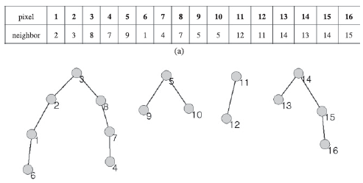
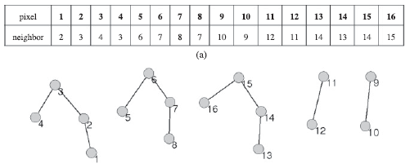
Method Overview
Definitions of Crossover
Two parent individuals
A mask is defined randomly
Example:
J1:
J2:
Notes:
1.5 min

Slide 18




Method Overview
Definitions of Crossover
J1:
Mask:
J2:
Result:
Notes:
1.5 min

Slide 19
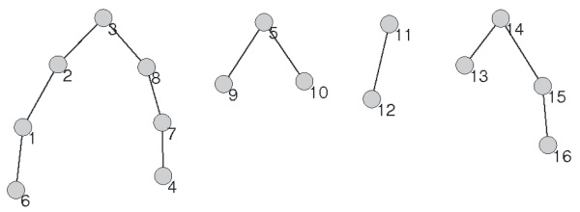
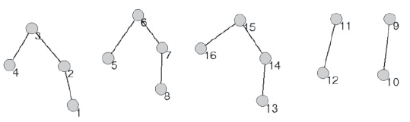
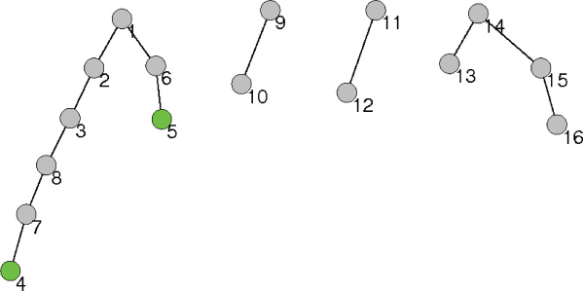
Method Overview
Definitions of Crossover
+
J1
J2
Offspring
Notes:
1.5 min

Slide 20
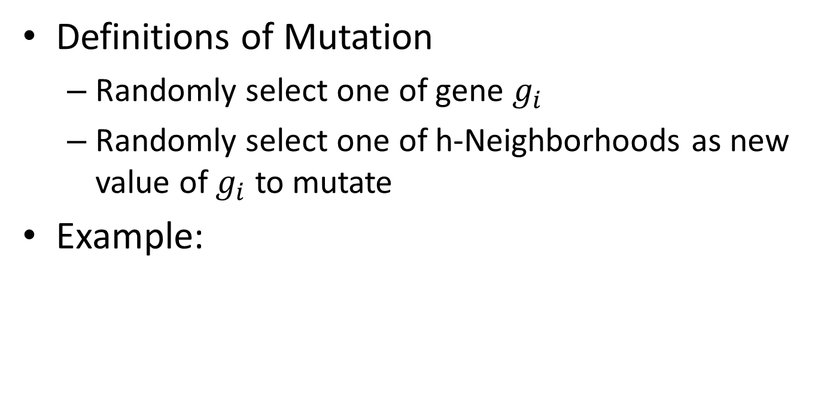
Method Overview
Definitions of Mutation
Randomly select one of gene $g_{i}$
Randomly select one of h-Neighborhoods as new value of $g_{i}$ to mutate
Example:
J1:
Notes:
1.5 min

Slide 21

Method Overview
Definitions of Mutation
J1:
Result:
Notes:
1.5 min

Slide 22
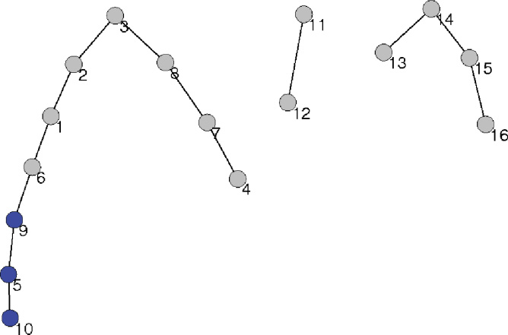
Method Overview
Definitions of Mutation
Mutation
Notes:
1.5 min

Slide 23



Method Overview
Evaluation Function of Method
WNCut function
To find the solution with minimal WNCut
Notes:
1.5 min
association

Slide 24







Segmentation Step
Initialization:
$$J_{1}$$
$$J_{2}$$
……
$$J_{n}$$
Mark Down
Best Solution
Evaluation:
$${WNCut}_{1},{WNCut}_{2},…,{WNCut}_{n}$$
Crossover
&Mutation
$${J′}_{1}$$
$${J′}_{2}$$
……
$${J′}_{n}$$
Stop
N
Y
Result
Notes:
1 min

Slide 25
My Contributions
Introduce hybridism framework with a two-level GA
Improvement the Evaluation Function by introducing double evaluation standard, combining the WNCut evaluation function with distance information between each individual and best solution.
All the design and the construction works of this project.
Notes:
30 sec.

Slide 26


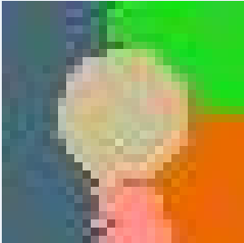



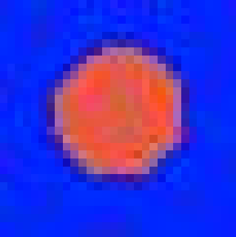
Why to do these improvements?
Why not combine them together to find the global solution?
hybridism
Notes:
1 min

Slide 27
Why to do these improvements?
distance information
best
d1
d2
d3
d4
$$V_{survival}=α∗e^{di}+\left(1−α\right)∗e^{−|{WNCut}_{i}−{WNCut}_{best}|}$$
Notes:
1 min

Slide 28

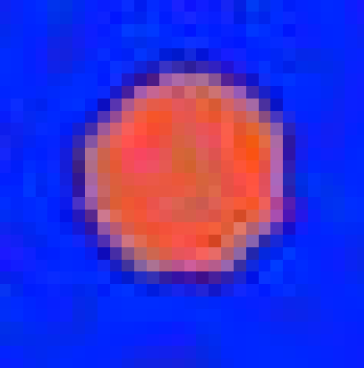
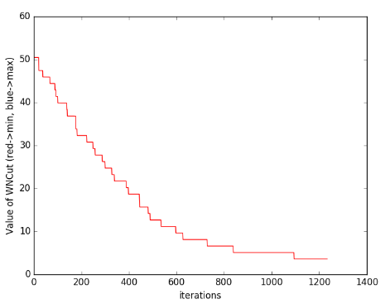
Experimental Result 1
Synthetic Image
Notes:
2 min

Slide 29


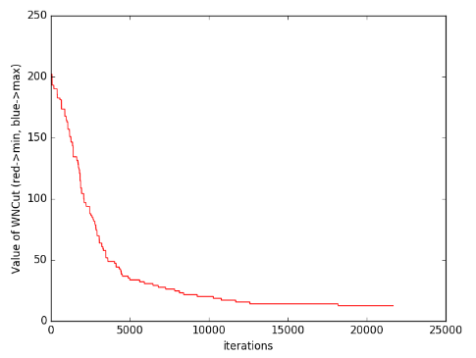
Experimental Result 2
Synthetic Image
Notes:
2 min

Slide 30
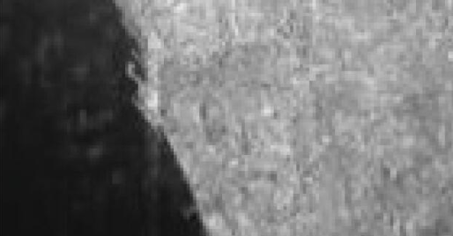

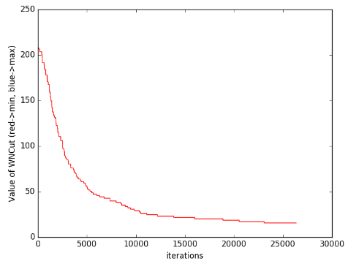
Experimental Result 2
Satellite Image
Notes:
2 min

Slide 31
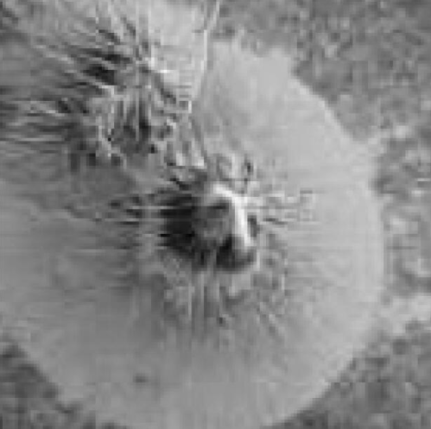

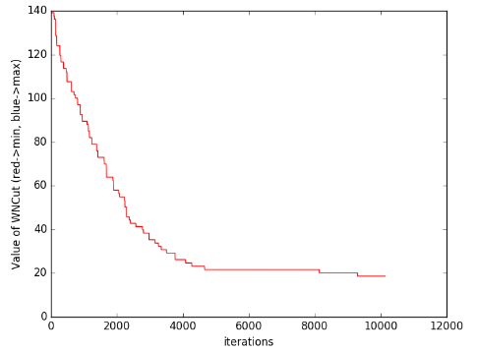
Experimental Result 2
Satellite Image
Notes:
2 min

Slide 32
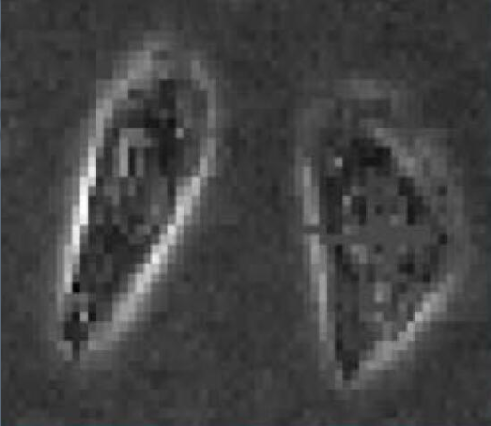

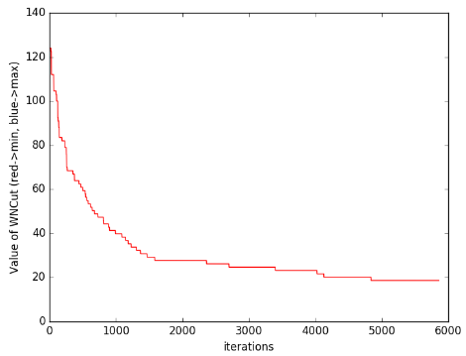
Experimental Result 2
Biological Image
Notes:
2 min

Slide 33
Comments
Weakness
High computing-time comsumption
Not very accurate segmentation
Potential Research Directions
Avoid local optimization by further improving the evaluation function
Speed up by parallel computing technique
Notes:
3 min

Slide 34
Thank you
Demonstration (if any)

